Slide 1
World War I
Geral

Slide 2
Introduction to world war 1
The world war 1 started in 1914 and ended in 1918
It is caused by the assassination of Archduke Franz Ferdinand in Serbia, 28th June 1914 shot dead by Gavrillo Princip
The assassination pull the triggered that leads to world war 1
The first war was declared by Austrio Hungary in Serbia, 1914
Allies vs. Central Powers
The great battle was so long in Europe

Slide 3
Battle of WWI, Verdun
1916: An amazing battle of France and Germany
Von Falkenhayn, the Crown Prince, and Pétain.
Battle of Verdun starts in February 21st 1916 and ended in December 16th 1916
A long battle
Verdun has a great defence with their fortresses.

Slide 4
Battle of Verdun
The German plan and prepare for attack on French and think that they could get their victory in Verdun
February 21st: Germany first attack to French, Verdun.
French retreated because Germany’s army are too strong.
There are many more attacks from the German to the French. German take many places in Verdun
The crisis of French defence.
The French finally attack back the Germany who had taken their places
11 December 1916 the French force the Germany to their original posistion
On 19 December 1916 the German suffered enough and pushed back, and they are defeated

Slide 5
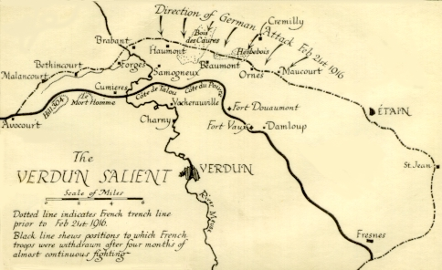

Slide 6
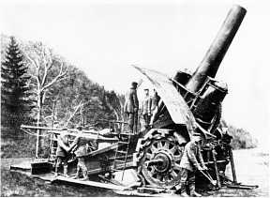
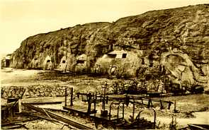
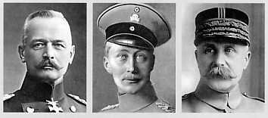
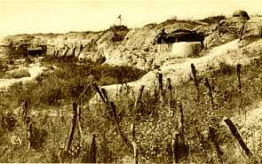
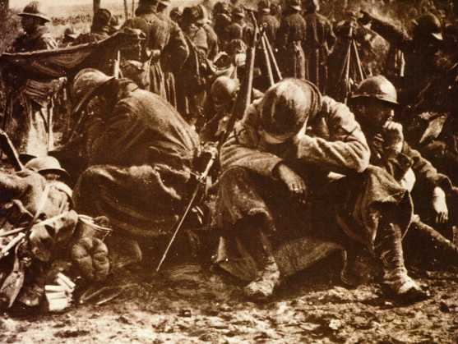
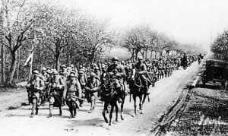
Pictures

Slide 7
Personalities of WWI
Vladimir Lennin, Russian
Influenced the Russians revolutions
He led the Bolshevik to murder the royal family and take over the government

Slide 8
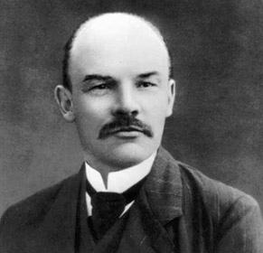
Vladimir Lenin
Brilliant man
High self confidence as arrogance
Focus man
He share hand written jokes in a long meeting to get other to laugh.

Slide 9
Weapons developed for use in WW1
Mustard Gas
Most deadly weapon used by Germans
It was fired into the trenches
Use masks to protect
Dead if breathed in. Painful.
Submarines
Topedoes/underwater missile
Blow up ships
When a torpedo launch to destroy a ship, it’s hopeless
Machine Guns
Fired 450-600 bullets per minute, 4-6 to work them
Machine gun for defensive. Protect their land
Offensive machine gun (1918) is portable

Slide 10
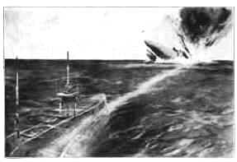
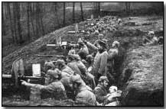
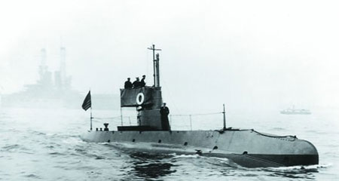
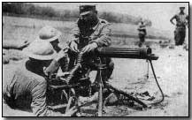
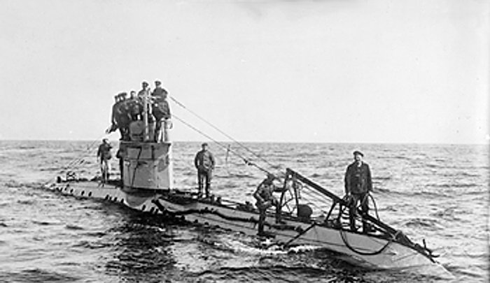
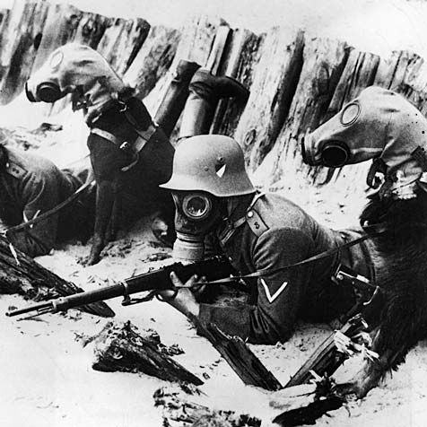
Pictures

Slide 11
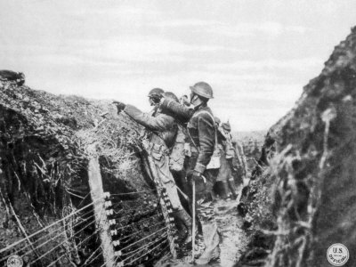
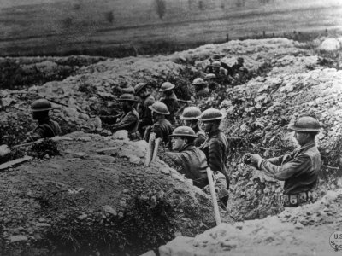
Trench Warfare during WW1
Trenches are used by soldiers to avoid/shelter them from enemy fire (rifles, machine guns)
The trench are formed by dugging it out for shelter.
The life there was a poor condition.
Soldiers died in trenches from diseases (bad weather, rats)
Unconfortable
Trench warfare killed people

Slide 12
Thank You :D

